Slide 1
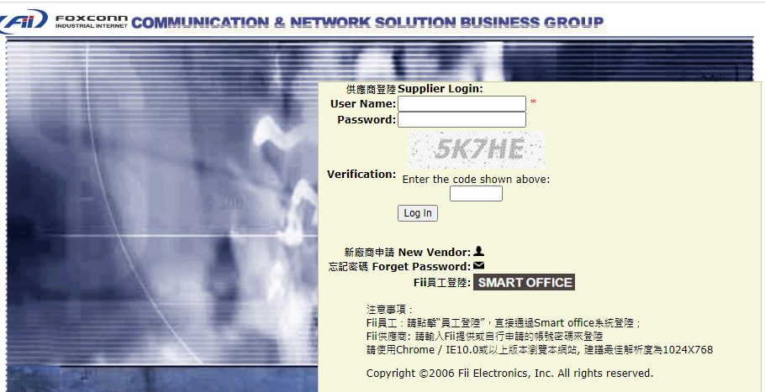
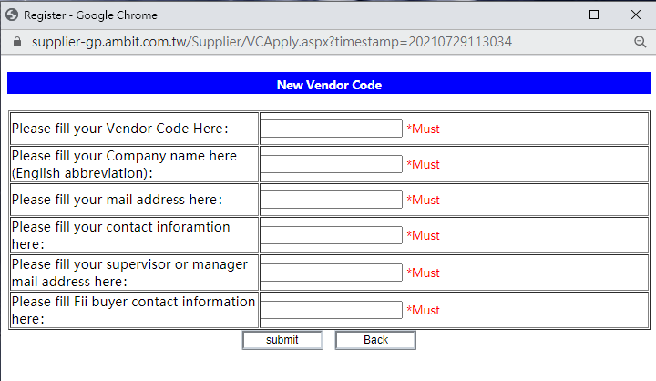
Supplier system login guide
New Vendor Register
Click New Vendor→ PoP up window will show the information you need to key in→submit → wait for administrator to verify→ will send login password to registered email
Company Name：Please fill in English with Capital letters; Must be the same with the parts vendor name

